Slide 1
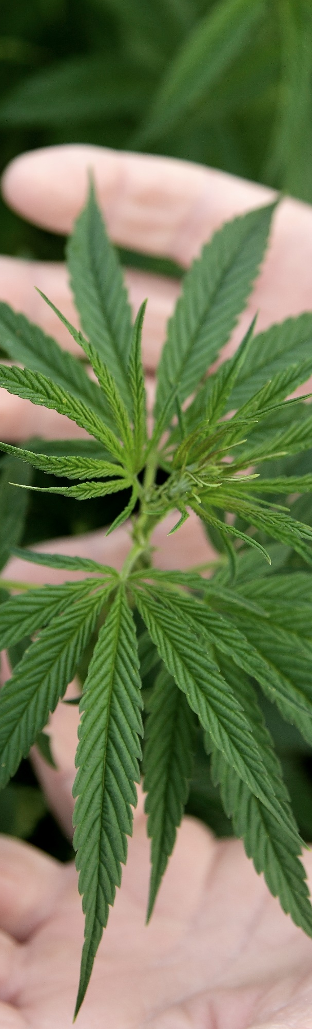

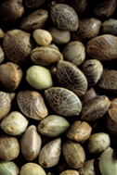
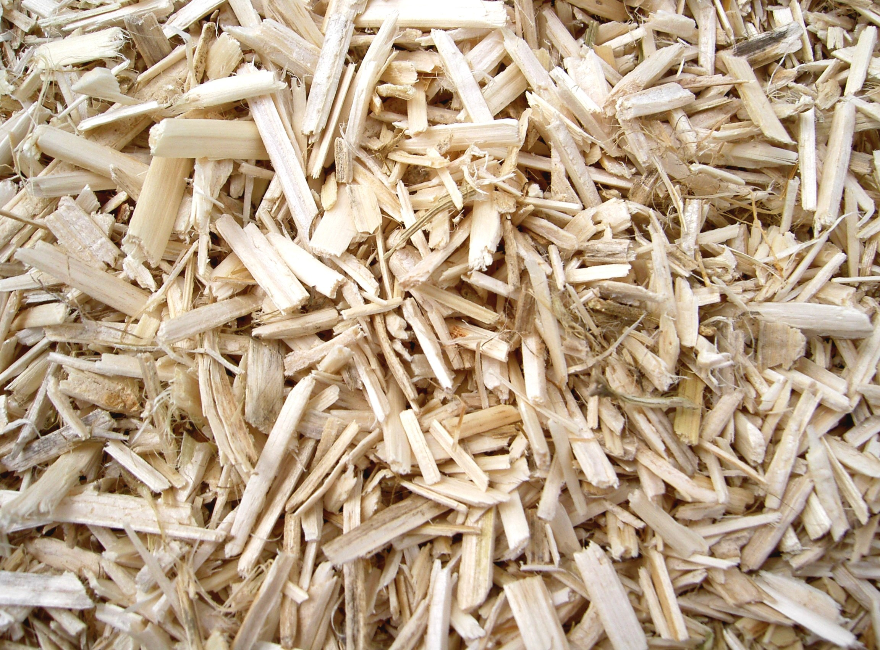
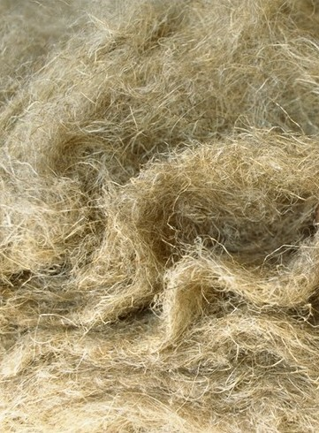
The European Hemp Pole
Building a hemp territorial ecosystem through cooperation

Slide 2
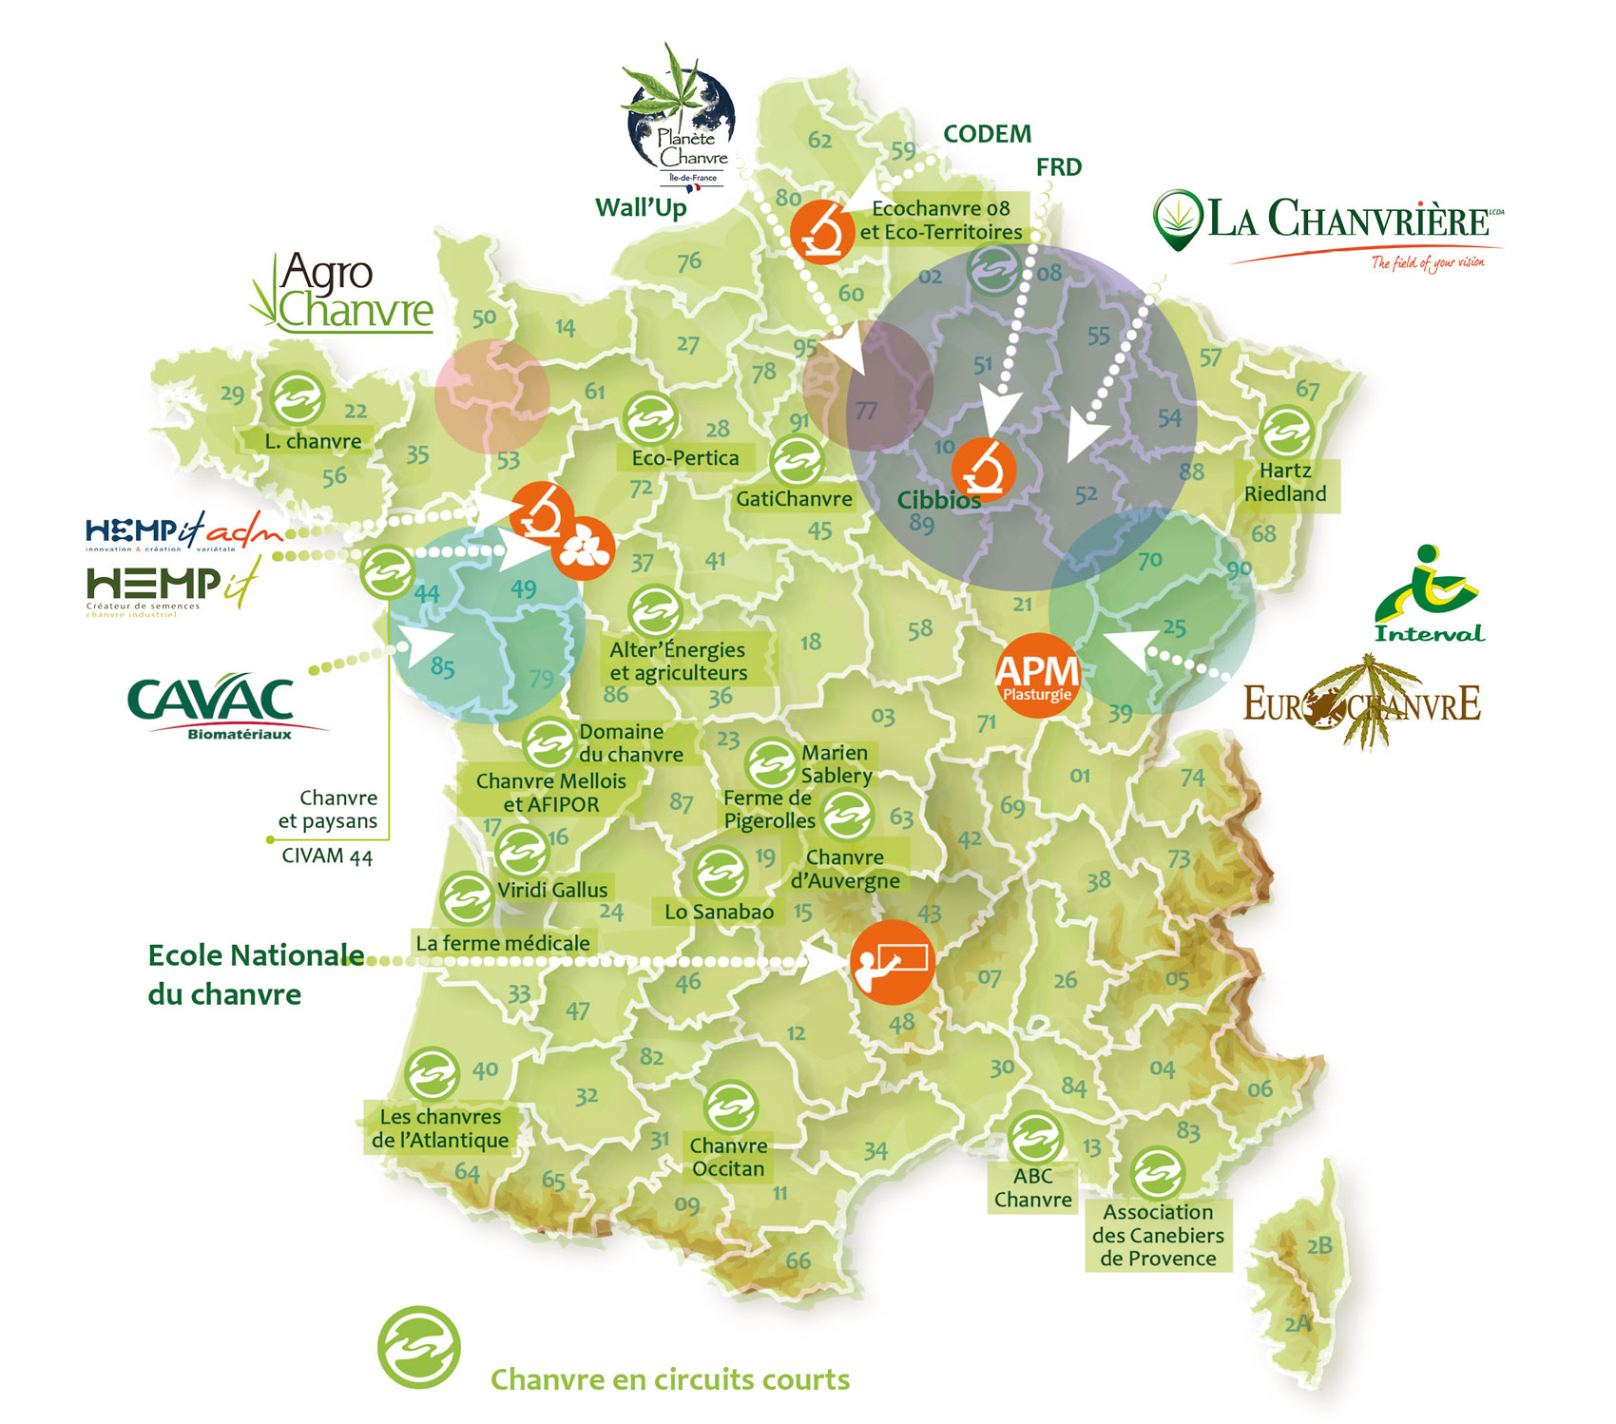

Hemp production in France

Slide 3
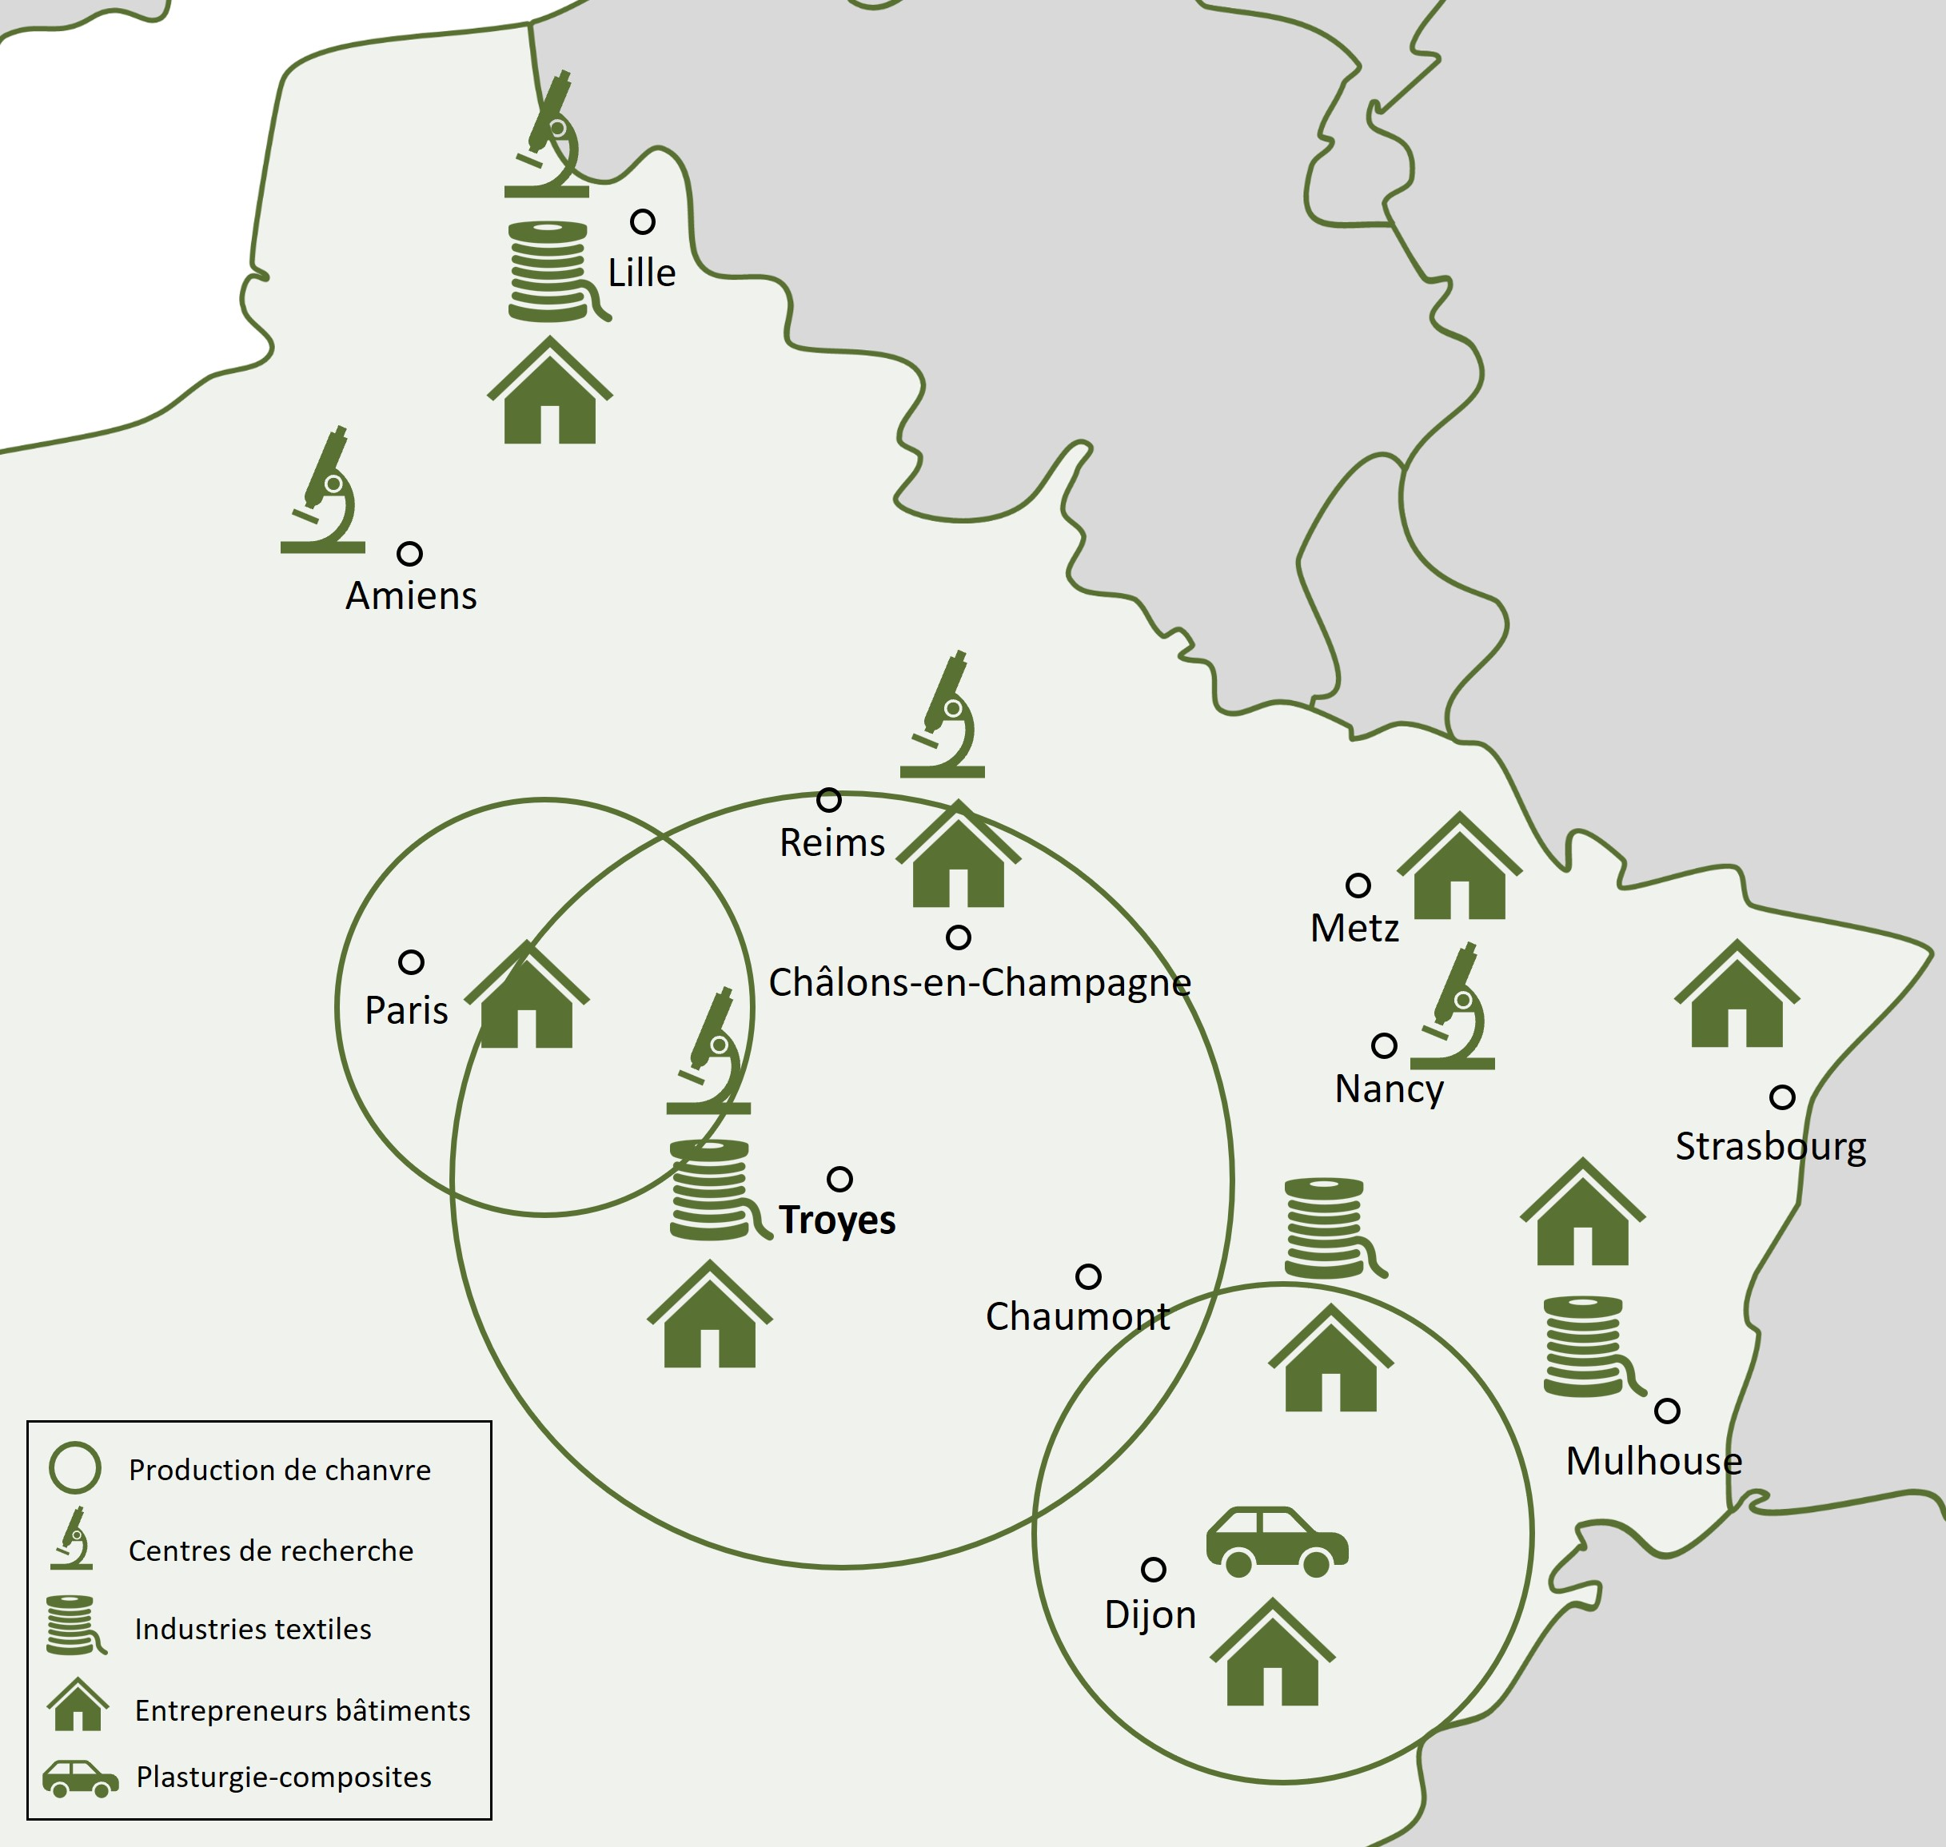
The hemp ecosystem in North-Eastern France

Slide 4
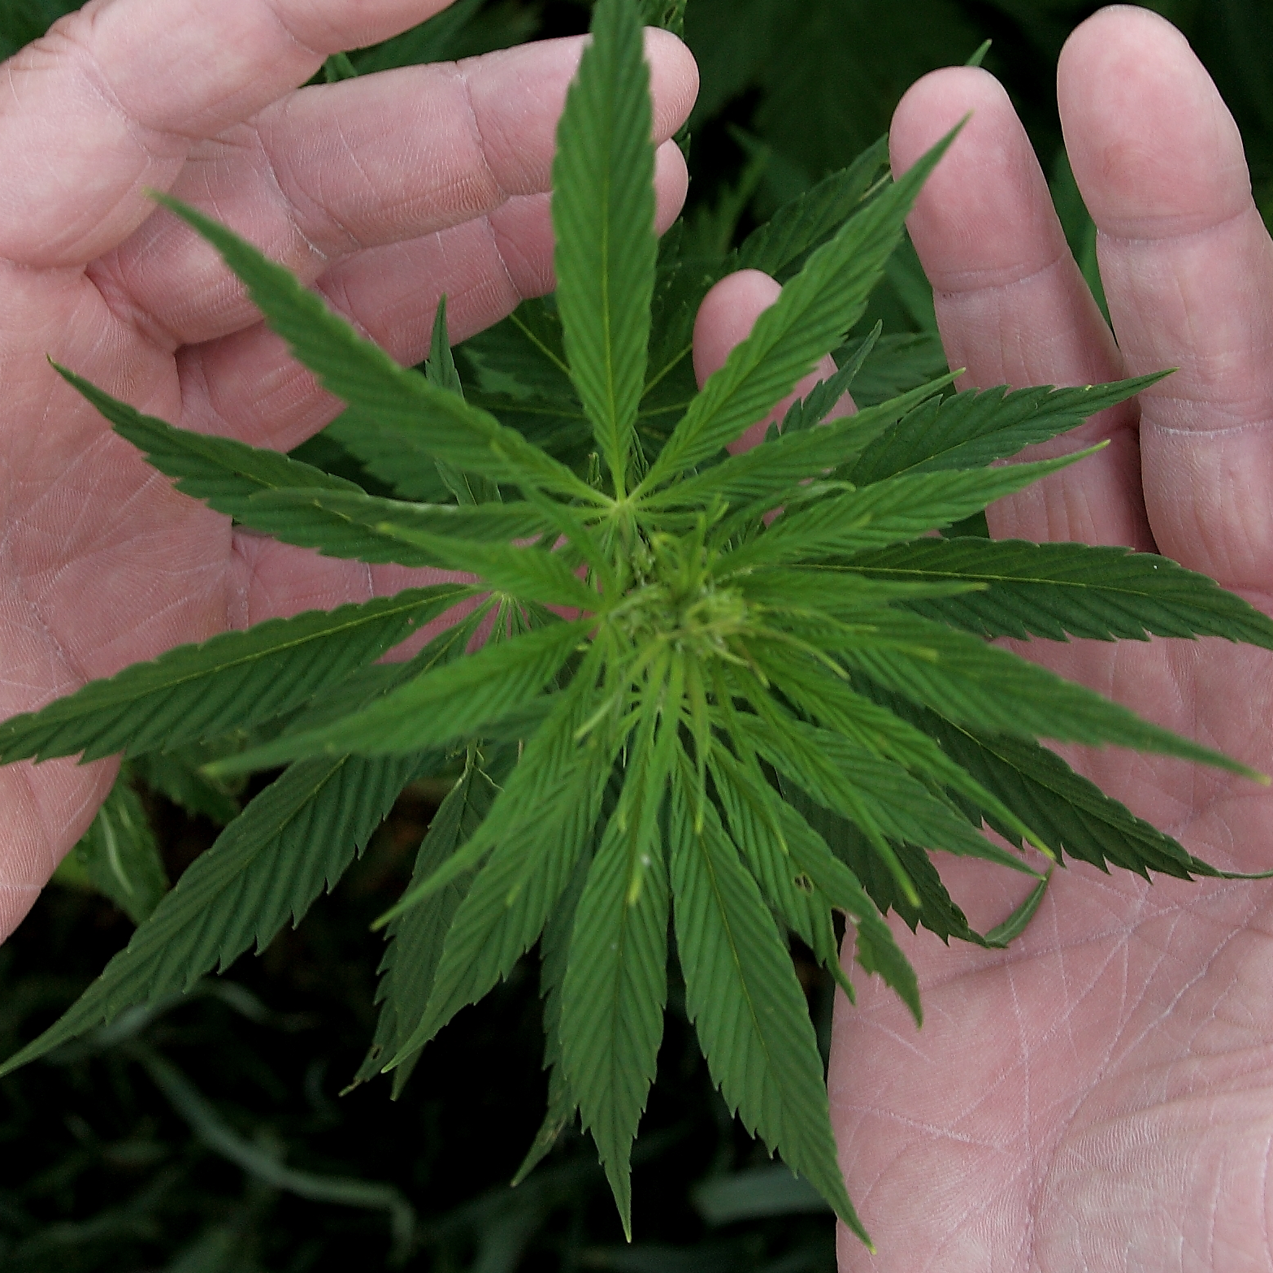


The European Hemp Pole : a cooperative ecosystem
Companies and brands
Farmers
Textile
Building
Research, development and innovation structures
Food & Feed
Industries
Multi-stakeholders
Multi-markets
Health & well-being
Teaching and training organisations
Local authorities
Cosmetics
Plastics and composites
Promotion and development agencies

Slide 5
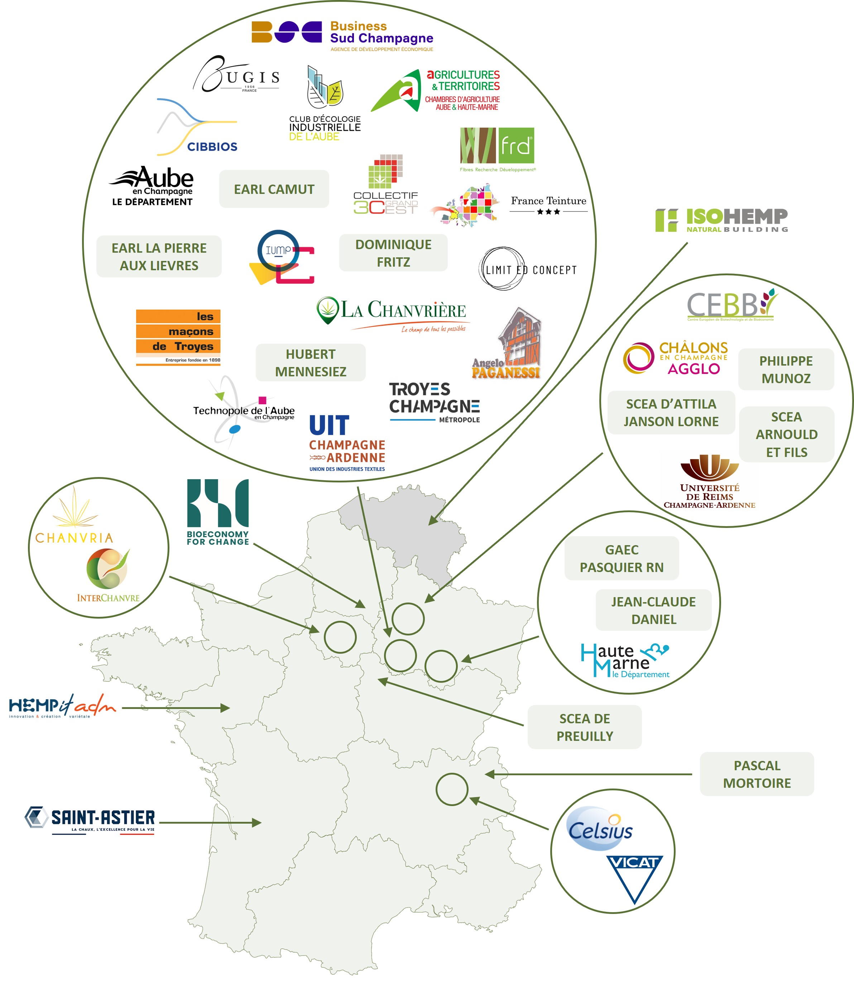
The European Hemp Pole : our members

Slide 6
The European Hemp Pole : our missions
Initiating, supporting and implementing projects that contribute to the territorial (economic, social and ecological) transitions, while developing the production, transformations and uses of hemp.
1
2
Supporting the development of cooperative projects :
Monitoring, inspiration, knowledge, networking, innovation :
Creating territorial pilots ;
Multi-market or/and multi-stakeholder projects;
Going beyond the mere business interest of 2-3 companies.
Prospective committee (transversal, multi-stakeholders)
Innovation clubs dedicated to all questions related to hemp
3
Informing, training, promoting :
4
Supporting territorial diagnosis
Information and training activities on the production and/or use of hemp;
Indexing and promoting hemp products and companies.
Helping each territory to identify its potential for hemp development (production, markets...)
Organising peer learning visits.

Slide 7
The European Hemp Pole
Contact :
Estelle DELANGLE
Pôle européen du chanvre
edelangle@polechanvre.eu
Tél : 06 24 03 40 78

